Slide 1

Week 1 Internship Report Computer Networking Fundamentals
Submitted By :
Name: Krina Sorathiya
Internship: DG Interns Hub
Week: 2
Submission Date: 14th August 2026

Slide 2
Introduction
The objective of Week 2 of the DG Interns Hub Cybersecurity Internship was to develop practical knowledge of advanced networking concepts, network traffic analysis, basic network scanning, and security attack concepts.
During this week, I studied common network ports and services, learned the functions of routers, switches, and firewalls, and explored basic network security concepts such as Man-in-the-Middle (MITM), Denial of Service (DoS), and packet sniffing.
I also performed practical activities using Wireshark, Nmap, and Cisco Packet Tracer.

Slide 3
PORTS & SERVICES:
Port | Protocol | Service | Usage
20 | TCP | FTP Data | Transfers file data
21 | TCP | FTP | FTP control connection
22 | TCP | SSH | Secure remote access
23 | TCP | Telnet | Remote terminal access
25 | TCP | SMTP | Sending email
53 | TCP/UDP | DNS | Domain name resolution
67 | UDP | DHCP Server | Provides IP configuration
68 | UDP | DHCP Client | Receives IP configuration
69 | UDP | TFTP | Simple file transfer
80 | TCP | HTTP | Web communication
110 | TCP | POP3 | Receiving email
123 | UDP | NTP | Time synchronization
135 | TCP | MS RPC | Windows RPC communication
139 | TCP | NetBIOS | Windows network communication
143 | TCP | IMAP | Email access
161 | UDP | SNMP | Network monitoring
389 | TCP/UDP | LDAP | Directory services
443 | TCP | HTTPS | Secure web communication
445 | TCP | SMB | File and printer sharing
3389 | TCP | RDP | Remote desktop access

Slide 4
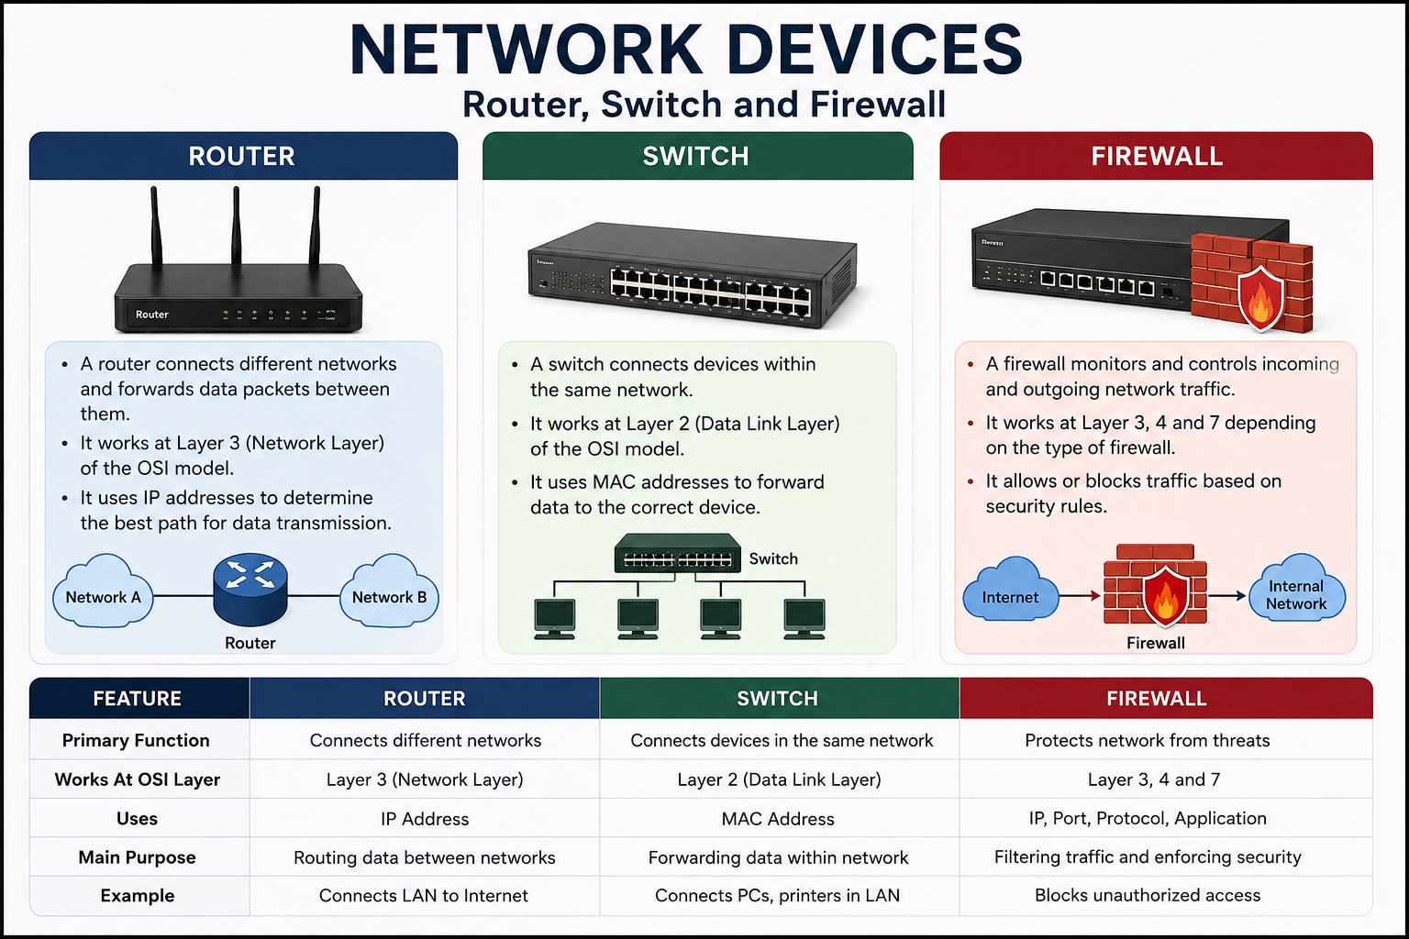
NETWORKING DEVICES

Slide 5
PACKET ANALYSIS USING WIRESHARK
Objective
To capture and analyze real network traffic using Wireshark and identify DNS requests, HTTPS traffic, source IP addresses, destination IP addresses, protocols, and port numbers.
Tool Used
Wireshark 4.6.7
Procedure
Opened Wireshark and selected the active Wi-Fi network interface.
Started packet capture.
Generated network traffic by browsing websites.
Stopped the packet capture after sufficient traffic was collected.
Applied display filters to analyze specific packets.
Identified DNS, TCP and TLS/HTTPS traffic.
Inspected source and destination IP addresses and port numbers.

Slide 6
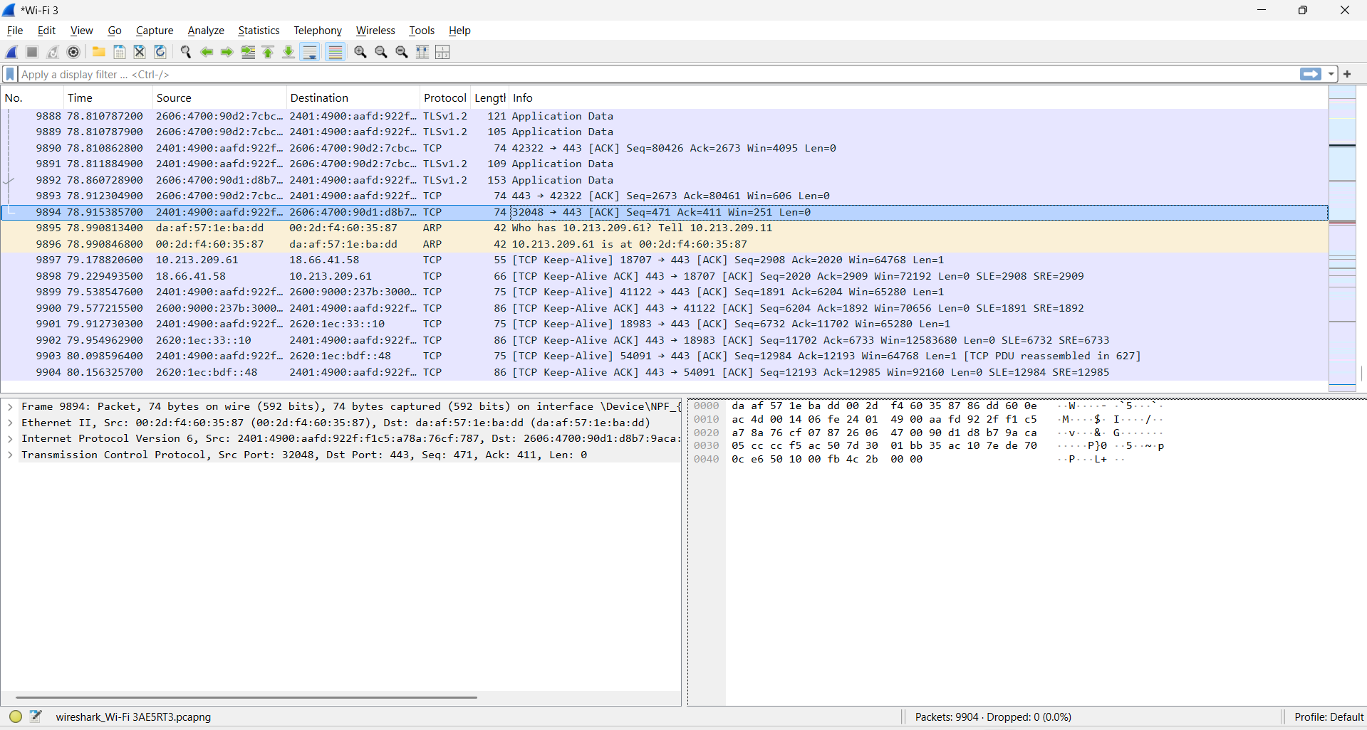
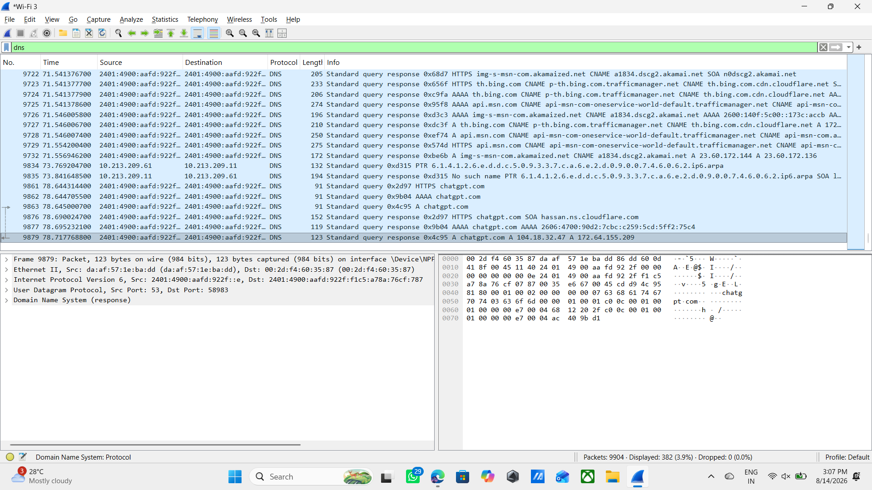
Filters Used

Slide 7
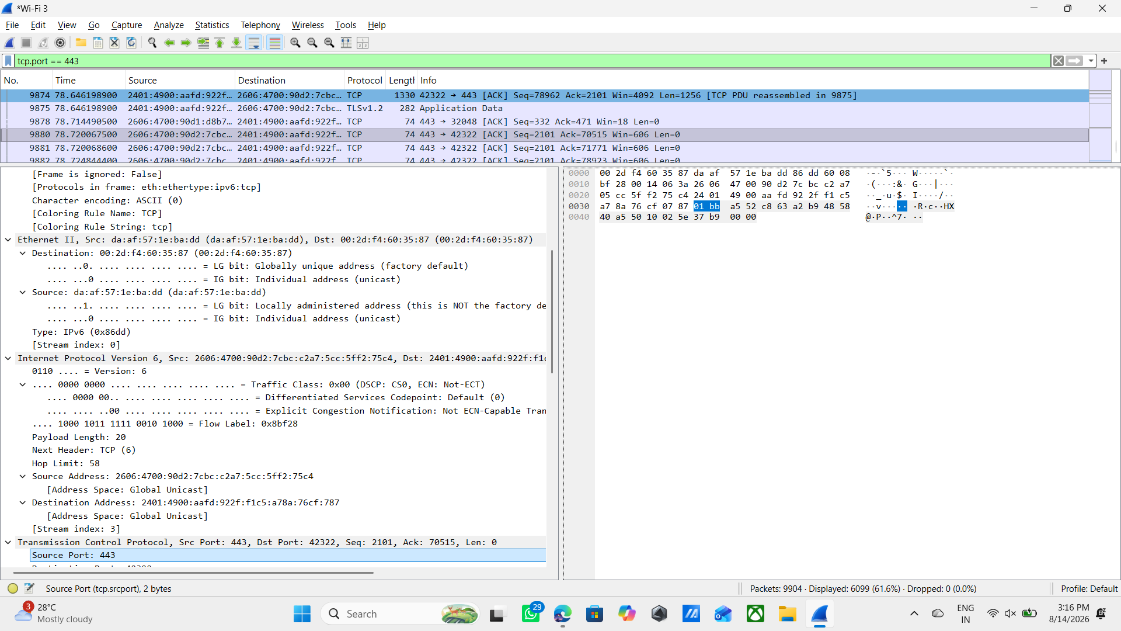
Filters Used
Filter | Purpose
dns | To identify DNS requests and responses
tcp.port == 443 | To identify HTTPS-related TCP traffic
ip | To view IP-based traffic

Slide 8
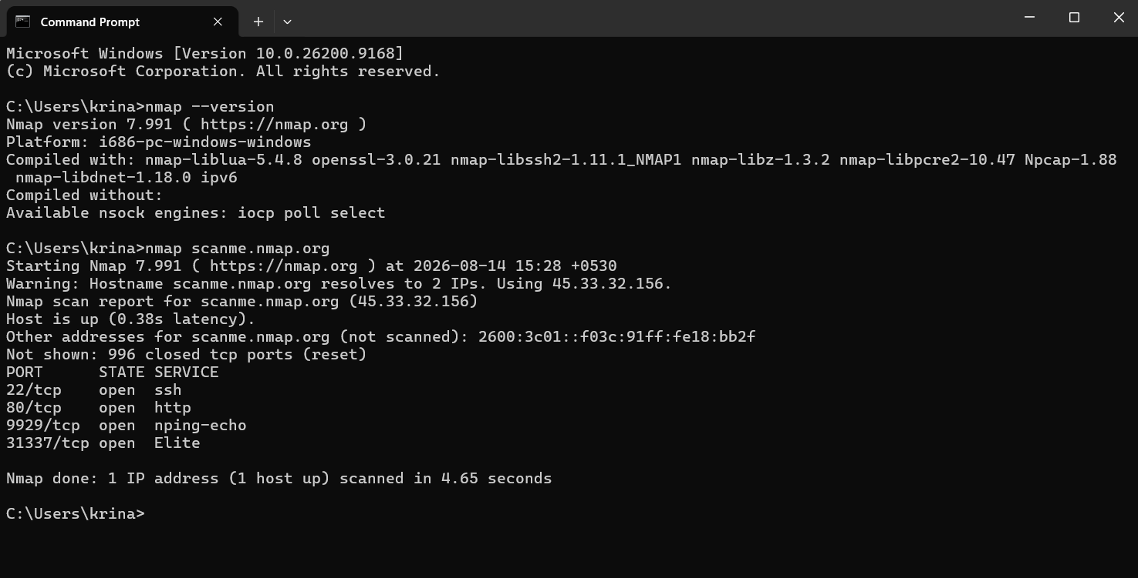
NETWORK SCANNING USING NMAP
Objective
To perform an authorized network scan using Nmap and identify the target's open ports and associated services in a safe environment.
Tool Used
Nmap 7.99
Authorized Target
scanme.nmap.org
The scan was performed only on the authorized Nmap
training target.
Commands Used
1. Check Nmap installation/version:
nmap --version
2. Basic network scan:
nmap scanme.nmap.org
3. Service/version detection:
nmap -sV scanme.nmap.org

Slide 9
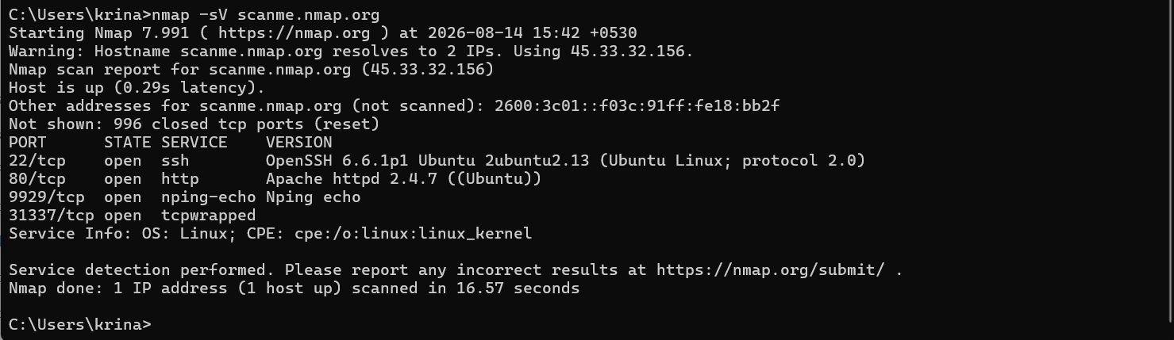
NETWORK SCANNING USING NMAP
Service Version Detection:
Command:
nmap -sV scanme.nmap.org

Slide 10
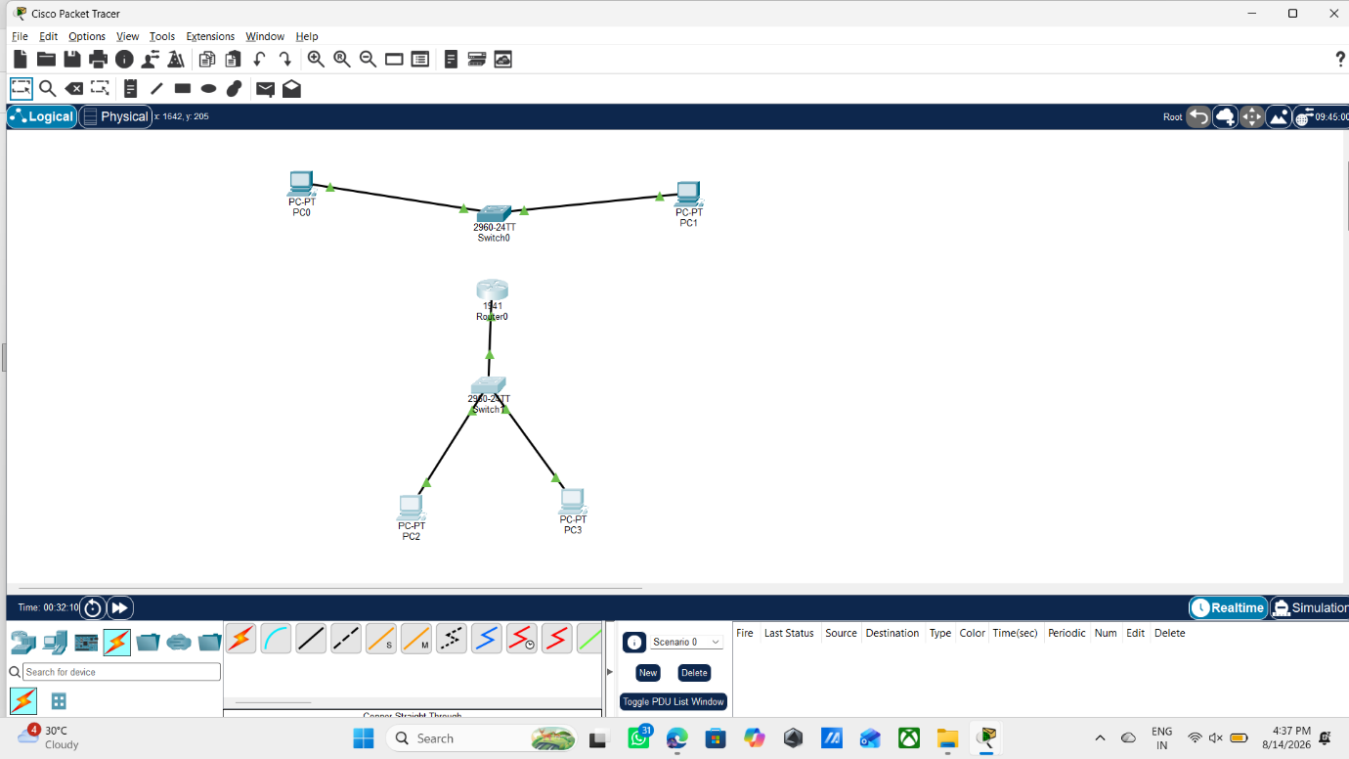
CISCO PACKET TRACER LAN SETUP
Objective
To perform an authorized network scan using Nmap and identify the target's open ports and associated services in a safe environment.
Tool Used
Nmap 7.99
Authorized Target
scanme.nmap.org
The scan was performed only on the authorized Nmap training target.
Commands Used
1. Check Nmap installation/version:
nmap --version
2. Basic network scan:
nmap scanme.nmap.org
3. Service/version detection:
nmap -sV scanme.nmap.org

Slide 11
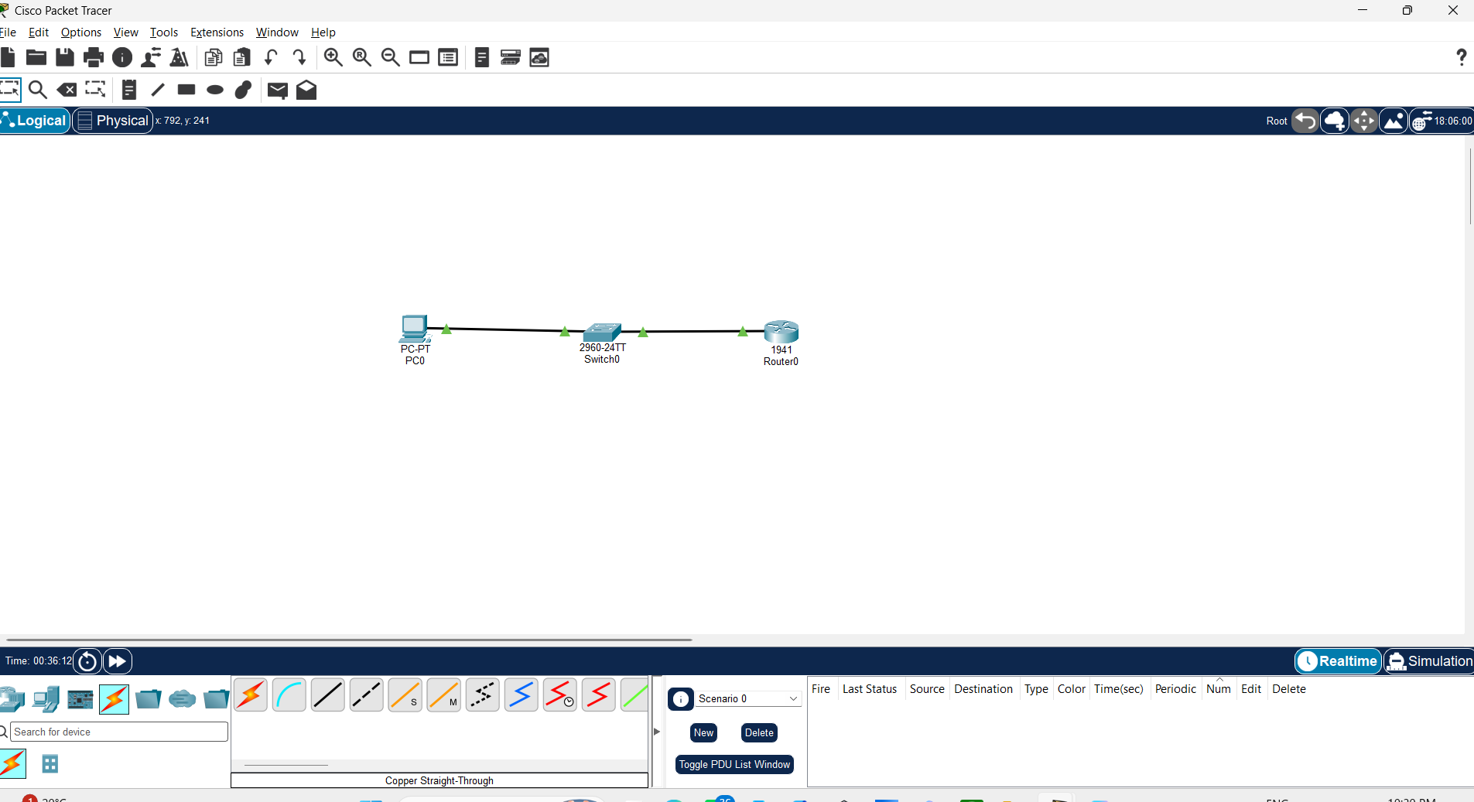
Cisco Packet Tracer Practical
Objective :
To create a simple network consisting of one PC, one Switch, and one Router.
Devices Used
PC
Cisco 2960 Switch
Router
Copper Straight-Through Cable
Network Topology
PC → Switch → Router

Slide 12
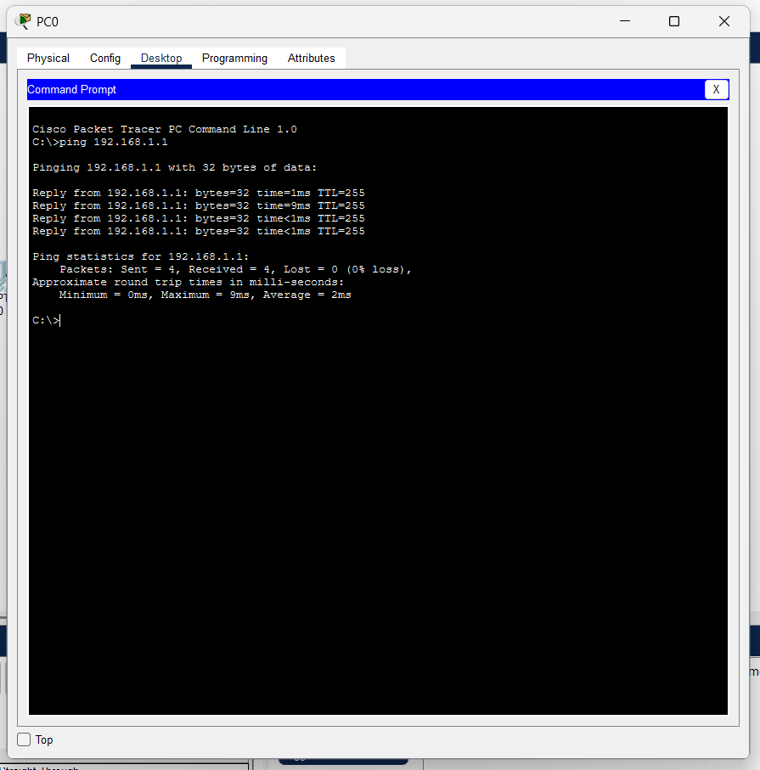
Connectivity Testing
After configuring the devices, the following command was executed:
ping 192.168.1.1
The router successfully responded, confirming that the network was configured correctly.

Slide 13
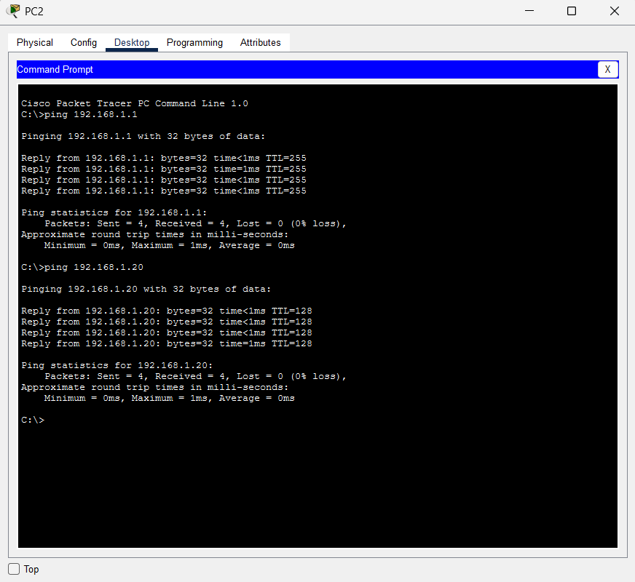
Connectivity Testing
Both PCs were configured with IP addresses from the same network:
192.168.1.0/24
The switch provided connectivity between the two devices. The successful ping confirmed that the IP configuration, physical connections, and local network communication were working correctly.
Result
The basic LAN was successfully created in Cisco Packet Tracer. Two PCs were connected through a switch, assigned appropriate IP addresses, and successfully tested using the ping command.

Slide 14
Learning Outcomes
Understood advanced networking concepts and common ports & services.
Learned the role of Routers, Switches and Firewalls.
Analyzed network traffic using Wireshark.
Identified DNS, TCP/HTTPS traffic, IP addresses and ports.
Performed authorized network scanning using Nmap.
Identified open ports and running services.
Created and tested a LAN using Cisco Packet Tracer.
Understood MITM, DoS and Packet Sniffing concepts.
Improved network troubleshooting and cybersecurity skills.

Slide 15
Conclusion
The DG Interns Hub Week 2 assignment provided practical exposure to networking and cybersecurity fundamentals.
Through the theory tasks, I learned about common ports, services, networking devices, and network security concepts.
Through practical activities, I used Wireshark to analyze network traffic, Nmap to perform authorized network scanning, and Cisco Packet Tracer to create and test network topologies.
The assignment also helped me understand how network security concepts such as MITM, DoS, and packet sniffing relate to real-world cybersecurity.
Overall, Week 2 improved my understanding of networking, network analysis, security concepts, troubleshooting, and responsible use of cybersecurity tools.

Slide 16

Thank you

